Slide 1
Programming Fundamentals
Lecture 6-9

Slide 2
Objectives
To know about Selective Structures
To learn the use of the break statement
To know the basics of counter controlled repetition
To learn the use of available iterative structures in C++

Slide 3
Selective Structure in C++
Selective structure is also used for decision making in C++
switch statement is most commonly used selective structure
We use the switch statement when we have a large decision tree, and all the decisions depend on the value of the same variable

Slide 4
The switch Statement
A switch statement allows a variable to be tested for equality against a list of values
Each value is called a case, and the variable being switched on is checked for each case
The statements following that case will execute until a break statement is reached
When a break statement is reached, the switch terminates, and the flow of control jumps to the next line following the switch statement

Slide 5
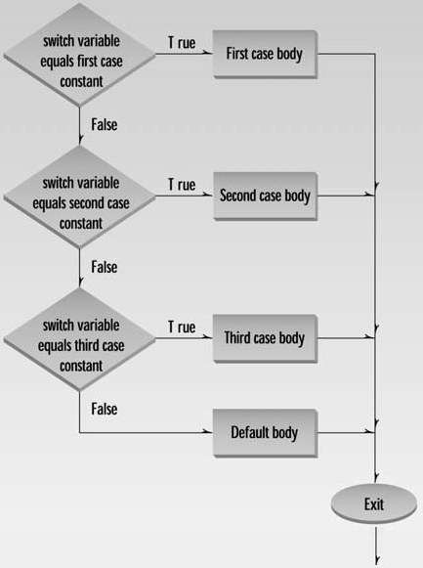
Syntax of switch, case and break
switch (expression)
{
case constant-expression
statements;
break;
case constant-expression
statements;
break;
default:
statements;
}

Slide 6
Some Rules for switch Statement
The expression used in a switch statement must have a basic data type, int, char for example
You can have any number of case statements within a switch
The constant-expression for a case must be the same data type as the variable in the switch, and it must be a constant
Not every case needs to contain a break. If no break appears, the flow of control will fall through to subsequent cases until a break is reached
A switch statement can have an optional default case, which must appear at the end of the switch. The default case can be used for performing a task when none of the cases is true

Slide 7
Comparison of if and switch
switch
Switch statement tests the variable for equality
It is only applicable for integral data types
The variable expression are also not allowed in cases (case i+2 is invalid)
It is much faster because as per the value of the switch, the control jumps to the corresponding case
if-else if
if-else if made the decisions by Boolean logic
It can be used for all data types
Variable expressions can be defined in else-if
It is less efficient in term of execution time because the control goes through the every else if statement until it finds true value of the statement or it comes to the end

Slide 8
When to Use What
There is no hard and fast rule with the use of else-if and switch, but these are the tips to select between above two
If there are a large number of comparisons of the same data type, then use of switch is recommended
In case of simple and few comparisons, if-else executes faster and easy to write
If decisions are depending on different variables/different data types, then if-else is the only option

Slide 9
Iterative Structures
Iterative structures are used to run the code/part of code for several times
Some iterative structures available in C++ are:
For
While
Do-while
All above have same purpose but used in different scopes

Slide 10
Essentials of Counter Controlled Repetition
Counter-controlled repetition requires
The name of a control variable (or loop counter)
The initial value of the control variable
The loop-continuation condition that tests for the final value of the control variable (i.e., whether looping should continue)
The increment (or decrement) by which the control variable is modified each time through the loop

Slide 11
for Loop
The “for” loop executes a section of code for a fixed number of times
It’s usually (although not always) used when you know, before entering the loop, how many times you want to execute the code

Slide 12
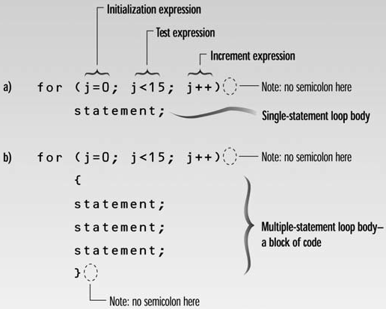
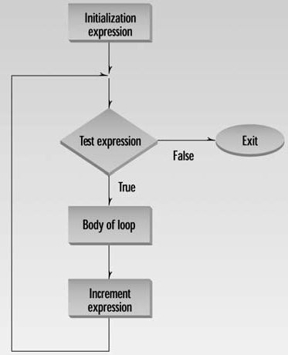
for Loop
The syntax and flow chart of for loop is given below

Slide 13
for Loop
We can use any valid arithmetic operator in for loop to modify the value of loop variable
Have a look at the following expressions and identify the number of iterations
for (int i=0; i<=10; i++)
for (int i=10; i>20; i--)
for (int i=0; i<=100; i+=10)
for (int i=0; i<=10; i*=2)
for (int i=0; i<50; i--)
for (int i=10; i<=1; i++)
for (int i=0; i<=10; i+3)
11 iterations (0 is included)
0 iterations (condition is false in 1st run)
11 iterations (0 is included)
infinite iterations (i will be 0 in each run)
infinite iterations (condition is always true)
0 iterations (condition is false in 1st run)
infinite iterations (i will never be updated)

Slide 14
Variable Visibility in Blocks
The loop body, which consists of braces determining the boundary of several statements, is called a block of code
Predict the output of the following code
for(int i=0; i<10; i++)
{
int num;
num = num * i;
}
cout<<num<<endl;
The above program will generate an error, because the variables defined inside any block are invisible to rest of code and cannot be accessed outside that block

Slide 15
Nested “for” Loop
A nested loop is a loop within a loop, an inner loop within the body of an outer one
C++ allows at least 256 levels of nesting
for (i=0;i<=5;i++)
{
for (j=0;j<=3;j++)
{
Statements;
}
}

Slide 16
Multiple Variables in a for Loop
There is no restriction on the use of multiple variables in a for loop
We can modify each variable within the loop
However the loop continuation condition will be only one
Here is the syntax of using multiple variables
for (int i = 0, j = 5; i<10; i++, j--)

Slide 17
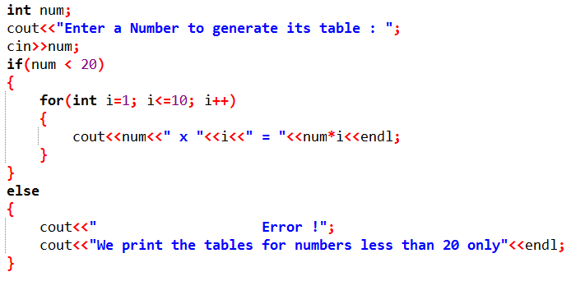
Practice Problem 1
Write a C++ code which should print the table of a number (up to 10 entries) entered by the user, if the number is less than 20, otherwise print an error.

Slide 18
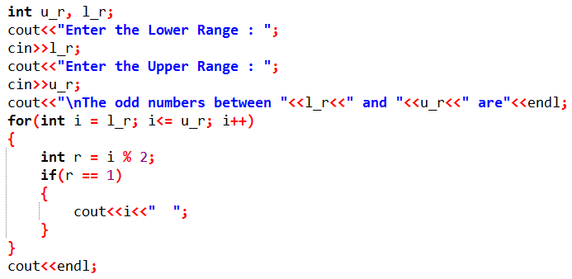
Practice Problem 2
Write a C++ code to print the odd numbers between two ranges entered by the user

Slide 19
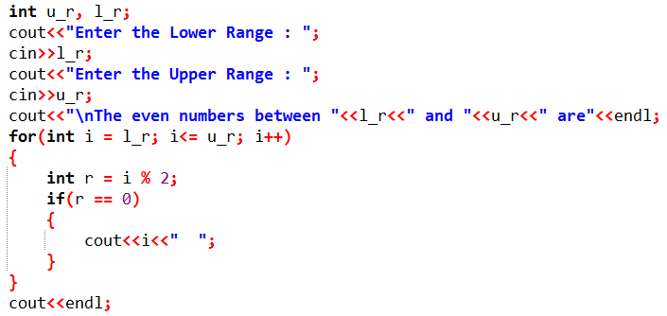
Practice Problem 3
Write a C++ code to print the even numbers between two ranges entered by the user

Slide 20

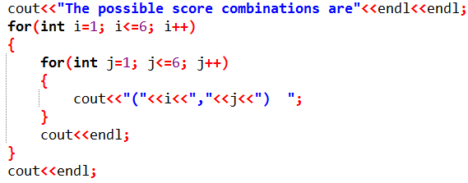
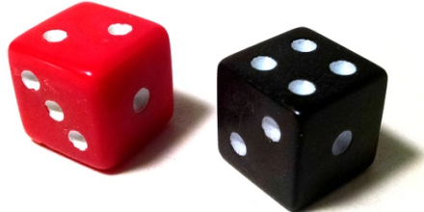
Practice Problem 4
2 dice are rolled at the same time, write a C++ program to list all the scores possible on each die

Slide 21
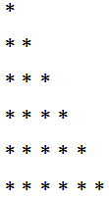
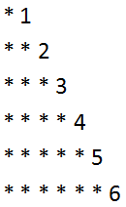
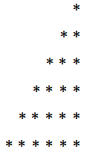
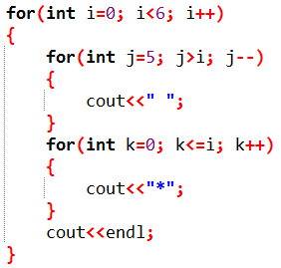
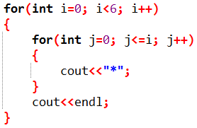
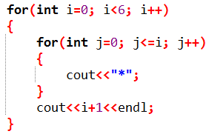
Practice Problem 5
Write the C++ codes to print the following patterns, one by one

Slide 22

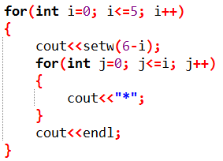

Practice Problem 5 (Modified)
Write the C++ codes to print the pattern 1 and 2 by using 1 for loop and pattern 3 by using a maximum of 2 for loops

Slide 23
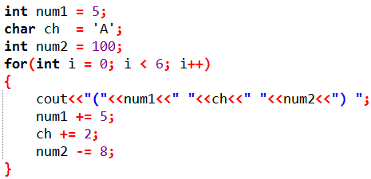
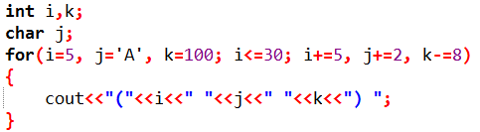
Practice Problem 6
Use for loop to print the following pattern
Method 1
Method 2

Slide 24
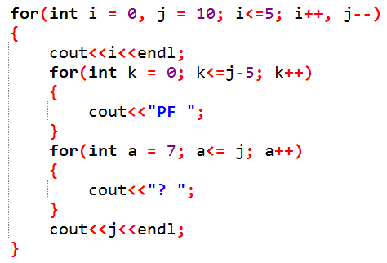
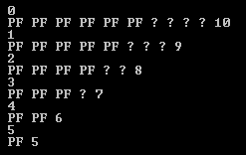
Practice Problem 7
What will be the output of following code

Slide 25
While Loop
Identical to for loop
Will repeat a specific section of code for multiple times
We use while loop when we don’t know exactly that how many times the code/section of code will repeat

Slide 26
Syntax of While Loop
while (test expression)
{
Statements;
}
While loop looks like a simple version of a for loop
It contains test expression but no initialization or increment/decrement

Slide 27
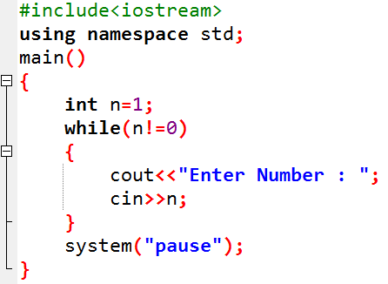
While Loop Example
The following code will keep asking the user to enter an integer until he/she enters a 0 value

Slide 28
The do loop (do-while loop)
Do loop will also repeat the specific section of code multiple times
The syntax of a do loop is given below
do
{
Statements;
}
while (condition);
Why we need a semicolon after while? In simple while loop didn’t have the semicolon.

Slide 29
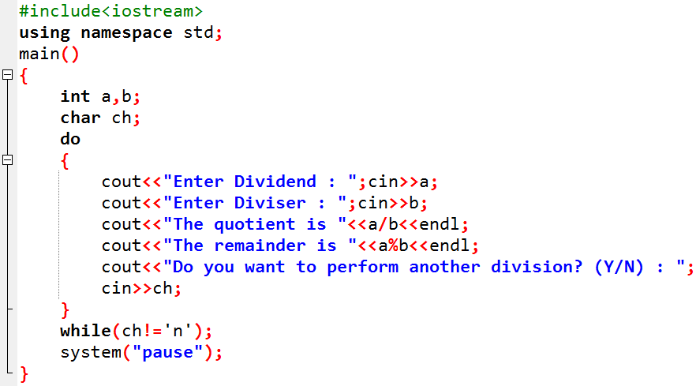
Example of do-while Loop
The following code will keep on dividing two numbers until user enters “n”

Slide 30
Comparison of “for”, “while” and “do” loop
for loop
Used when we know that how many times the code/section of code will repeat
Runs for fixed number of times and minimum iterations are 0
while loop
Used when we don’t know that how many time the code will repeat
Iteration will depend on loop condition
Loop condition is evaluated at the start→ loop will iterate minimum 0 times
do-while loop
Used to repeat a code until the user wants
Condition is evaluated at the end of loop→ loop will iterate at least 1 time

Slide 31
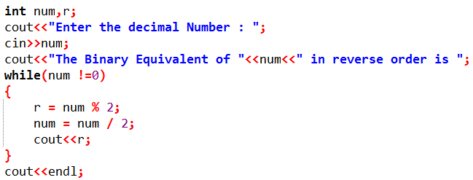
Practice Problem 8
Write a C++ program to convert the decimal number to binary.

Slide 32
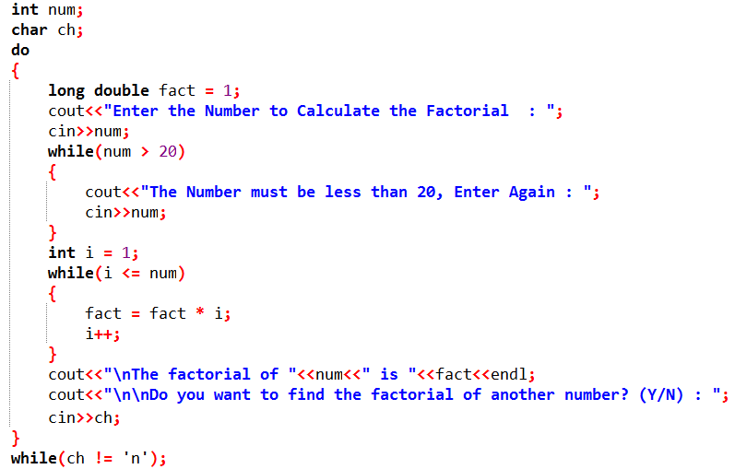
Practice Problem 9
Write a C++ program to calculate the factorial of any number (less than or equal to 20) until user wants. If user enters a number greater than 20 then code should ask the user to enter the number again.

Slide 33
The goto Statement
A goto statement in C++ programming provides an unconditional jump from the 'goto' to a labeled statement in the same function
The syntax of a goto statement is given below
Label:
Statements;
goto Label;
Here label can be any plain text except C++ keyword and it can be set anywhere in the C++ program above or below to goto statement, but it is recommended to declare the label before the goto keyword

Slide 34
Analysis of goto Statement
goto statement works on unconditional jump
It makes the compiler to work hard so execution time increases
It makes difficult to trace the control flow of a program, making the program hard to understand and hard to modify
Any program that uses a goto can be rewritten to avoid them
Use of goto statement is highly discouraged in any programming language

Slide 35
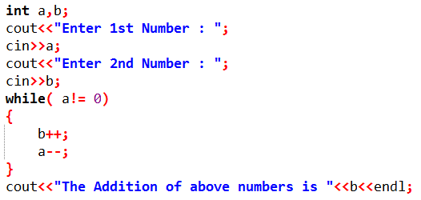
Practice Problem 10
Write a C++ program to add two integers entered by the user without using +, -, += or -= operator.
Hint
++ operator and a loop will be used in this

